Slide 1
Integrating Reporting Services

Slide 2
Using Reporting Services Without the Report Manager
The Report Manager provides a nice interface for finding and executing reports.
However, the Report Manager is not always the best way to deliver a report to your users.
Perhaps the user is browsing your website or using a custom application and needs to view a report.
In these situations, it does not make sense to force the user to jump to the Report Manager and begin navigating folders.
We want to deliver the report to the user right where they are. In this section, we explore several ways to do just that.

Slide 3
URL Access
One way to execute a report without using the Report Manager is through Uniform Resource Locator (URL) access.
URL access allows a browser or a program capable of issuing Hypertext Transfer Protocol (HTTP) requests to specify a URL and receive a report in the HTML report viewer.
This URL can be built into a standard Hypertext Markup Language (HTML) anchor tag to allow a report to be displayed with one mouse click.
The basic URL used to access a report has two parts. The first part is the URL of the report server web service. In a default installation, this is
http://{computername}/ReportServer
where {computername} is the name of the computer hosting the report server.
In addition to executing reports, you can view the contents of folders, resources, and shared data sources. Try the following:
Enter this URL in the address bar:
http://localhost/ReportServer?/Galactic Delivery Services
Click Go. The contents of the Galactic Delivery Services folder appear.
Click the link for the 2013 Conference folder. The contents of the 2013 Conference folder appear

Slide 4
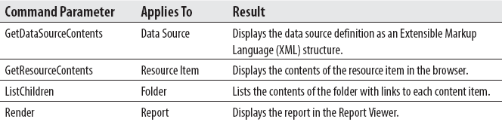
Command Parameters
If you look at the URL in the address bar you see something has been added to the URL, namely &rs:Command=ListChildren. This is called a command parameter.
It tells Reporting Services what to do with the item pointed to by the URL. The four possible values for the command parameter are listed in table below.
Looking at this table, you quickly realize that only one command parameter value applies to each type of item you can encounter in the Reporting Services virtual folders.
Attempting to use a command parameter with the wrong type of item results in an error. If you do not include the command parameter, Reporting Services simply performs the one and only command that applies to the type of item you are targeting in your URL.

Slide 5
Passing Parameters
You can pass the values for report parameters as part of the URL. On the URL, include an ampersand (&) followed by the name of the report parameter, an equals sign, and the parameter value.
Try the following:
Enter the following URL in the address bar:
http://localhost/ReportServer?/Galactic Delivery Services/Axelburg/Invoice-Batch Number Report&StartDate =11/1/2012&EndDate=11/30/2012
Click Go. The Invoice-Batch Number Report appears with data for November 2012.
It is possible to hide parameters from interactive report users, while still allowing values to be passed to those parameters through the URL or web service access.
This is done through the Hide option for each parameter. Let’s try the following:
Open the Report Manager, and navigate to the /Galactic Delivery Services/Axelburg folder.
Hover over the Invoice-Batch Number Report item, and select Manage from the drop-down menu.
Click Parameters on the left side of the page.

Slide 6
Passing Parameters
Check the Hide check box in the StartDate row. (Notice the default value for the StartDate parameter is 1/1/2012.)
Click Apply.
Click the large report title at the top of the page to execute the report. Notice the Start Date prompt no longer appears in the parameter area.
Enter the following URL in the address bar:
http://localhost/ReportServer?/Galactic Delivery Services/Axelburg/Invoice-Batch Number Report&StartDate=12/1/2012&EndDate=12/31/2012
Press enter. The Invoice-Batch Number Report appears with data for December 2012.
Even though the StartDate parameter does not appear in the parameters area, we can still specify a value for it other than the default value.
The Hide check box is not checked for the City parameter. Instead, the Prompt User check box is unchecked.
In this situation, you cannot specify a value for this parameter in the URL.

Slide 7
Controlling the Report Viewer
In addition to specifying report parameters in the URL, you can include parameters to control the format of the response from Reporting Services.
You can specify which rendering format should be used for the report.
Rather than using the Export dropdown list in the Report Viewer to export the report to a particular format, you can have it delivered in that format straight from Reporting Services.
Enter the following URL in the address bar:
http://localhost/ReportServer?/Galactic Delivery Services/2013 Conference/Nametags&rs:Format=PDF
Press enter.
If you are prompted whether to open or save the file, click Open.
The Nametags Report appears in PDF format in Adobe Acrobat Reader.
Close Adobe Acrobat Reader.

Slide 8
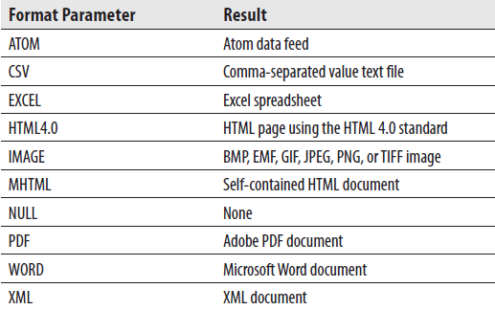
Controlling the Report Viewer
The valid format parameters are shown in table below.

Slide 9
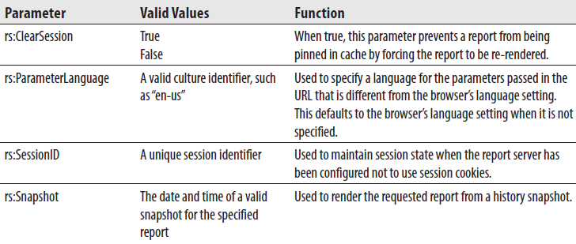
Controlling the Report Viewer
In addition to the rs:Command and rs:Format parameters, several other report server parameters use the rs: prefix. Table below shows these.

Slide 10
Web Service Access
In addition to URL and HTTP Post access, you can access reports by using the web service interface. This is the same interface used by the Report Manager web application to interact with Reporting Services.
This means anything you can do in Report Manager, you can also do through the web service interface.
The web service interface provides additional functionality not available through URL access. For example, the web service interface enables you to specify a set of credentials to use when executing a report.
This allows your custom application to use a set of hardcoded credentials to access reports through the web service interface.
This can be a big benefit in situations where you want Reporting Services reports to be exposed on an Internet or extranet site where each user does not have a domain account.

Slide 11
Using a Web Service Call to Execute a Report
This example takes you through the steps necessary to execute a report using the web service interface.
In this example, you build a web application that acts as a front end for the Axelburg Invoice-Batch Number Report.
Creating a Project and a Web Reference - First, you need to create an ASP.NET project with a reference to the Reporting Services web service.
Start up Visual Studio.
Create a new project.
Select Visual Basic | Web in the Installed Templates area.
Select ASP.NET Web Application from the Templates area.
Type AxelburgFrontEnd for Name. Select an appropriate location for this project.
Click OK.
When the new project has been created, right-click the project folder for this new project in the Solution Explorer, and select Add Service Reference from the context menu. The Add Service Reference dialog box appears.

Slide 12
Using a Web Service Call to Execute a Report
Click the Advanced button. The Service Reference Settings dialog box appears.
Click Add Web Reference. The Add Web Reference dialog box appears.
Enter the following address for the web reference:
http://{computername}/ReportServer/ReportExecution2005.asmx
where {computername} is the name of the computer hosting the report server.
Click Go.
When the ReportExecutionService Description appears in the dialog box, replace the Web reference name with RptExecSvc. Click Add Reference.
To use a web service, you need to create code that knows how to send data to and retrieve data from that web service.
Fortunately, this code is generated for you by Visual Studio through the process of creating a web reference.
Once the web reference is in place, you can call the methods of the web service the same way you call the methods of a local .NET assembly.

Slide 13
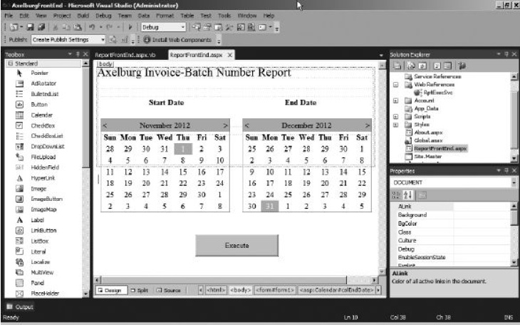
Using a Web Service Call to Execute a Report
Creating the Web Form Now, we need to create the web form that is going to serve as our user interface.
Change the name of Default.aspx to ReportFrontEnd.aspx.
Using the Design view of the ReportFrontEnd.aspx form, place three labels, two calendar controls, and a button on the web form, as shown in figure below.

Slide 14
Using a Web Service Call to Execute a Report
Creating the Web Form Now, we need to create the web form that is going to serve as our user interface.
Change the Text property of each label to match figure in previous slide.
Change the ID property of the left calendar control to calStartDate.
Set the SelectedDate property and the VisibleDate property of calStartDate to November 1, 2012.
Change the ID property of the right calendar control to calEndDate.
Set the SelectedDate property and the VisibleDate property of calEndDate to December 31, 2012.
Change the ID property of the button to cmdExecute.
Change the Text property of the button to Execute.
Double-click the cmdExecute button to open the code window.
Enter the following code for cmdExecute_Click: (add code from source code provided).

Slide 15
Using a Web Service Call to Execute a Report
Click Save All on the toolbar.
Select Debug | Start from the main menu. This executes your program.
When the browser window opens with the web application front-end page, click Execute. The report appears using the dates selected on the front-end page.
Switch back to Visual Studio and select Debug | Stop Debugging from the main menu.

Slide 16
The Report Viewer Control
The Report Server web service gives you a tremendous amount of control over report access.
However, the web service simply provides our applications with a stream that contains the report.
It is up to our applications to provide an appropriate method for viewing the content of that report stream.
The Report Viewer control in Visual Studio 2005, Visual Studio 2008, and Visual Studio 2010 takes things one step further.
Not only does it provide access to the reports, it also provides a means to view them. In fact, the Report Viewer can even free you from the tether to the report server altogether.
The Report Viewer control can be used in both Windows forms and web forms.

Slide 17
Displaying a Report from a Report Server
We first use the Report Viewer control to access a report on the report server.
In this example, you build a Windows application that uses the Report Viewer to display the Axelburg Invoice-Batch Number Report.
For this application to function properly, it must have access to the report server whenever a report is executed.
Creating a Project and an Instance of the Report Viewer - First, you need to create a Windows application project in Visual Studio.
Start up Visual Studio.
Create a new project.
Select Visual Basic | Windows in the Installed Templates area.
Select Windows Forms Application from the Templates area.
Enter AxelburgRVFrontEnd for Name. Select an appropriate location for this project.
Click OK. A Windows application project with a Windows form, called Form1, is created.
Expand Form1 so it covers the design surface.
Select the Toolbox window.

Slide 18
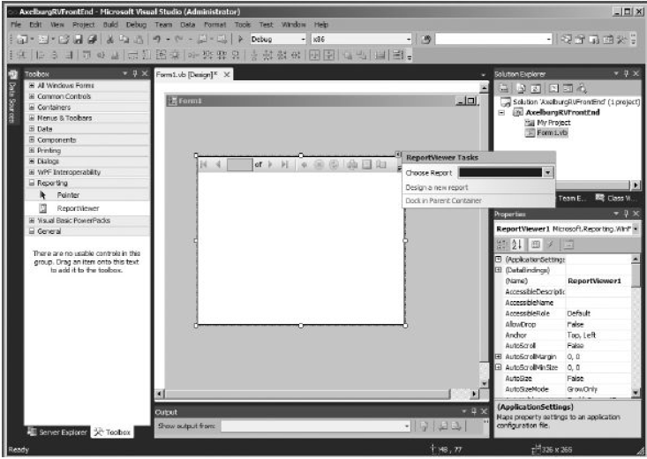
Displaying a Report from a Report Server
Locate the Reporting section of the Toolbox and, if it is not already expanded, expand it.
Drag the ReportViewer control from the Toolbox and drop it on Form1 (see figure below).
Click the Dock in parent container link in the ReportViewer Tasks dialog box.design surface.

Slide 19
Displaying a Report from a Report Server
Configuring the Report Viewer - Now we need to point the Report Viewer at a report. You need to make several selections from the ReportViewer Tasks dialog box. If this dialog box is invisible, click the small black triangle in the upper-right corner of the Report Viewer control.
In the ReportViewer Tasks dialog box, select <Server Report> from the Choose Report drop-down list.
Enter http://{computername}/reportserver for Report Server URL, where {computername} is the name of the server hosting Reporting Services.
Enter /Galactic Delivery Services/Axelburg/Invoice-Batch Number Report for Report Path.
Click Save All on the toolbar.
Select Debug | Start Debugging from the main menu. Form1 executes and displays the Invoice-Batch Number Report from the report server.

Slide 20
Displaying a Local Report in the Report Viewer
So far, all the methods of accessing reports we looked at in this chapter have required a report server.
The report server provides a number of advantages for managing reports, including centralized control for updating report definitions and maintaining security.
However, in some situations, it is impractical or undesirable for all installations of an application to pull reports from a report server.
The Report Viewer control provides an alternative. In addition to displaying reports rendered by a report server, the Report Viewer can render reports contained within the Visual Studio project.
In this example, we create a simple report right in the Visual Studio project, and then display it with the Report Viewer.
Creating a Local Report - We begin by creating a report in the Visual Studio project.
Close Form1 containing the report to return to Visual Studio, if you have not already done so.
Open the ReportViewer Tasks dialog box.
Click the Design a new report link. The Welcome page of the Report Wizard appears.

Slide 21
Displaying a Local Report in the Report Viewer
Make sure Database is selected, and click Next. The Choose a Database Model page of the Data Source Configuration Wizard appears.
Make sure Dataset is selected, and click Next. The Choose Your Data Connection page of the Data Source Configuration Wizard appears. Click New Connection. The Choose Data Source dialog box appears.
Click New Connection. The Choose Data Source dialog box appears.
Select Microsoft SQL Server from the Data source list, and click Continue. The Add Connection dialog box appears.
Create a connection to the Galactic database. Use SQL Server authentication, with GalacticReporting as the user and G@l@ct1c as the password. Remember to check the Save my password check box. Select Galactic from the Select or enter a database name drop-down list. Test the connection to make sure you configured it correctly. When the connection passes the test, click OK to exit the Add Connection dialog box.
Select the radio button next to “Yes, include sensitive data in the connection string,” and click Next. The Save the Connection String to the Application Configuration File page of the wizard appears.

Slide 22
Displaying a Local Report in the Report Viewer
In most cases, it makes sense to store the connection information in the configuration file to make maintenance easier. Leave the default setting of Yes, and click Next. The Choose Your Database Objects page appears.
Expand the stored procedures node, and place a check mark next to stp_EmployeeList. Enter EmployeeList for the DataSet name.
Click Finish. A typed dataset is created by the wizard for use with the report, and you are taken to the Dataset Properties page of the Report Wizard dialog box.
Enter EmployeeList for Name.
Click Next. You are taken to the Arrange fields page of the Report Wizard dialog box.
Drag all three fields to the Values area.
Click Next. The Choose the layout page of the Report Wizard appears.
Click Next. The Choose a style page of the Report Wizard appears.
Click Finish.
Click Save All on the toolbar.

Slide 23
Displaying a Local Report in the Report Viewer
Point the Report Viewer at the Local Report - Now, we point the Report Viewer at the new local report.
Click the Form1.vb [Design] tab in the layout area of Visual Studio 2010.
Open the ReportViewer Tasks dialog box.
Select AxelburgRVFrontEnd.EmployeeList.rdlc from the Choose Report drop-down list. Several items have been added to an area below the Form1 layout. Click Save All on the toolbar.
Select Debug | Start Debugging from the main menu. Form1 executes and displays the local report. The local report you just created shows a list of all Galactic employees.
Close Form1 when you finish viewing this report.
When you compile the AxelburgRVFrontEnd project, the Report1.rdlc report definition is compiled as an embedded resource in the executable.
Therefore, the data source is the only thing needed for the report to be rendered. The report always goes along with the application.

Slide 24
The RS Utility
The RS utility is used to execute scripts that can interact with Reporting Services.
The scripting language supported by the RS utility is Visual Basic .NET. This scripting language supports the complete web service interface to Reporting Services.
The RS utility automatically creates a reference to the web service interface. This predefined reference, called rs, means you do not need to instantiate the web service interface; it is simply ready to go.
All the Reporting Services classes and data types are also available. The following sample code lists the contents of the Galactic Delivery Services virtual folder:
Enter the following into Notepad or some other text editor:
Public Sub Main()
Dim items() As CatalogItem
items = rs.ListChildren("/Galactic Delivery Services", False)
Dim item As CatalogItem
For Each item In items
Console.WriteLine(item.Name)
Next item
End Sub

Slide 25
Report-Authoring Practices
The following practices can make your report-authoring process more efficient and more consistent.
A standard look and feel is usually desirable as users move from one report to the next.
The ability to be responsive to your users and create reports in a timely manner is always a plus.
Use Report Templates
A number of tasks in report authoring can be repetitive, such as placing the company name and logo at the top of the page and placing the page number and date of execution at the bottom.
Rather than wasting time creating these items afresh on each report, use one or more report templates.
The report templates enable you to start your report layout with these redundant items already present.
In addition, the report templates let you provide a common look and feel to your reports.
Templates can help ensure that certain style elements, such as a logo image or a page number in a certain location, are always present. The templates can help to enforce this common look and feel across a number of report authors.

Slide 26
Use Shared Data Sources
Shared data sources can help cut down on management headaches. They centralize the storage of database credentials.
If a database is moved to a new server, fewer places exist to change the connection information.
If the database logon credentials are changed, fewer locations must be modified.
Shared data sources also facilitate the use of production and development database servers.
Report development can be done using a shared data source pointing to the development database server.
A shared data source with the same name can exist on the production report server pointing to the production database server.
With the Overwrite Data Sources option turned off, the shared data source from the development environment does not overwrite the shared data source in the production environment.
Instead, the report goes seamlessly from querying development data in the development environment to querying production data in the production environment.

Slide 27
Use Views and Stored Procedures
Give your report authors rights to query views and execute stored procedures.
Avoid giving them rights to the underlying tables. Having them operate with views and stored procedures makes it easier to enforce security and maintain privacy.
It also prevents accidental data modifications and deletions.
Use Navigation Features
Take advantage of the document map, bookmark, drilldown, and drillthrough capabilities to make your reports more usable. These navigation features make it easier for your users to find the information they are looking for.
Drilldown and drillthrough make it possible to hide complex detail until your user specifically requests it.
Finally, drillthrough allows several reports to be linked together into a working unit. Remember, the goal of reporting is to convey information to the end user.
This is done best when a user can quickly navigate to desired information and follow the data intuitively from one level of detail to another or from one report to another.
The Reporting Services navigation features make this possible.

Slide 28
Report Deployment Practices
The practices listed here can help you move reports from the development environment to the production report server.
You need to make sure there is some level of control over which reports can access your production data.
You also need to control who can do what on your production report server.
Create a Backup of the Encryption Key
This tip is not a report deployment practice, but it does help protect all the reports and shared data sources you have deployed to the report server.
Occasionally, the key used to encrypt all the sensitive information stored on the report server becomes corrupt.
When this happens, all that sensitive information is no longer accessible. The report credentials stored with each shared data source can no longer be decrypted and used.
Worse yet, the credentials stored in the RSReportServer.config file cannot be decrypted, so the Report Server Windows service can no longer connect to the Report Catalog.
In short, everything comes to a screeching halt. If you do not have a backup copy of the encryption key, the only way to recover from this situation is to create a new encryption key and then reenter all the credential information.

Slide 29
Review Reports Before Deploying
It is generally a good idea to have reports reviewed before they are put into production.
This is especially true if you have nondevelopers creating their own reports.
You need to make sure efficient queries are being used to extract the data so an undue burden is not placed on the database server.
You also need some level of assurance the information the report claims to present is the information being pulled from the database.
Use Linked Reports
Rather than deploying duplicate copies of the same report to your report server, use linked reports.
Each linked report can have its own default parameters and its own security.
At the same time, updates to that report are done in one centralized location.
This helps prevent the confusion that can arise from having multiple versions of the same report running in the production environment at the same time.

Slide 30
Use Folders and Descriptions to Organize Reports
If your Reporting Services installation is as successful as we all hope, soon tens or even hundreds of reports will reside on your report server.
With this number of reports, organizing the reports properly to aid both the end users and the administrators is important.
Otherwise, both the users and the administrators can become frustrated. Organize your reports into logical groupings in folders.
Use the tree structure of the folders to create a multiple-level structure.
You should create enough folders so no folder contains too many reports, but not so many folders that the structure becomes cumbersome.
Use meaningful report names and add informational descriptions to each report.
Remember, both the report name and the description are searchable in Report Manager.
Then make sure your users know how to use this search function.

Slide 31
Assign Security at the Folder Level
Make your security role assignments at the folder level. Let the reports inherit their security from the folders they reside in.
Assigning individual security roles to individual reports is cumbersome and easily leads to errors.
Your security practices should be relatively easy to implement; otherwise, they will not be followed.
Assign Security to Domain Groups
By the same token, it makes more sense to assign roles to domain groups than try to assign roles to each individual user.
Just as with assigning security at the report level, making assignments at the user level causes things to become very complex very rapidly.
The simpler security policy is usually better, because it is the one more likely to be followed.

Slide 32
Assign Only the Rights Needed
Only give each user the rights they need to complete their required tasks. Assigning broad rights rather than narrow is easier, but this can lead to security breaches and problems managing the report server.
Take the time to create custom security roles that provide users with only those rights they need.
Then use these custom roles as you are granting access to domain groups.
The additional time taken during setup is more than made up for in the time saved not having to clean up after users who were doing things they shouldn’t have been able to do in the first place.
Hide Items
Keep the folders looking as clean and uncluttered as possible. Use “Hide in tile view” to hide items the user does not need to interact with.
This might include shared data sources or subreports. If the user should not click an item, then the user has no reason to see it in the folder.
Remember, however, this is not a security measure. The user can easily click Details View to reveal any of these hidden items. Security rights provide security; “Hide in tile view” is a means of keeping things neat.

Slide 33
Deploy Supporting Items to the Report Server
The report server has the capability to store and serve supporting information.
Documentation for your reports should be created as HTML pages, Word documents, PDF documents, Excel spreadsheets, and even PowerPoint presentations.
These items can then be deployed to the report server right in the folders with the reports.
This makes it easier for your users to understand the content and appropriate use of each report.
Use Caching and Snapshots
Use caching and snapshots to reduce the load on your report server and increase performance.
Set up scheduled snapshots to execute long-running reports during off-hours.
It is a fact, users will not care if their data is eight hours old when they can get their reports back in seconds!

